Slide 1

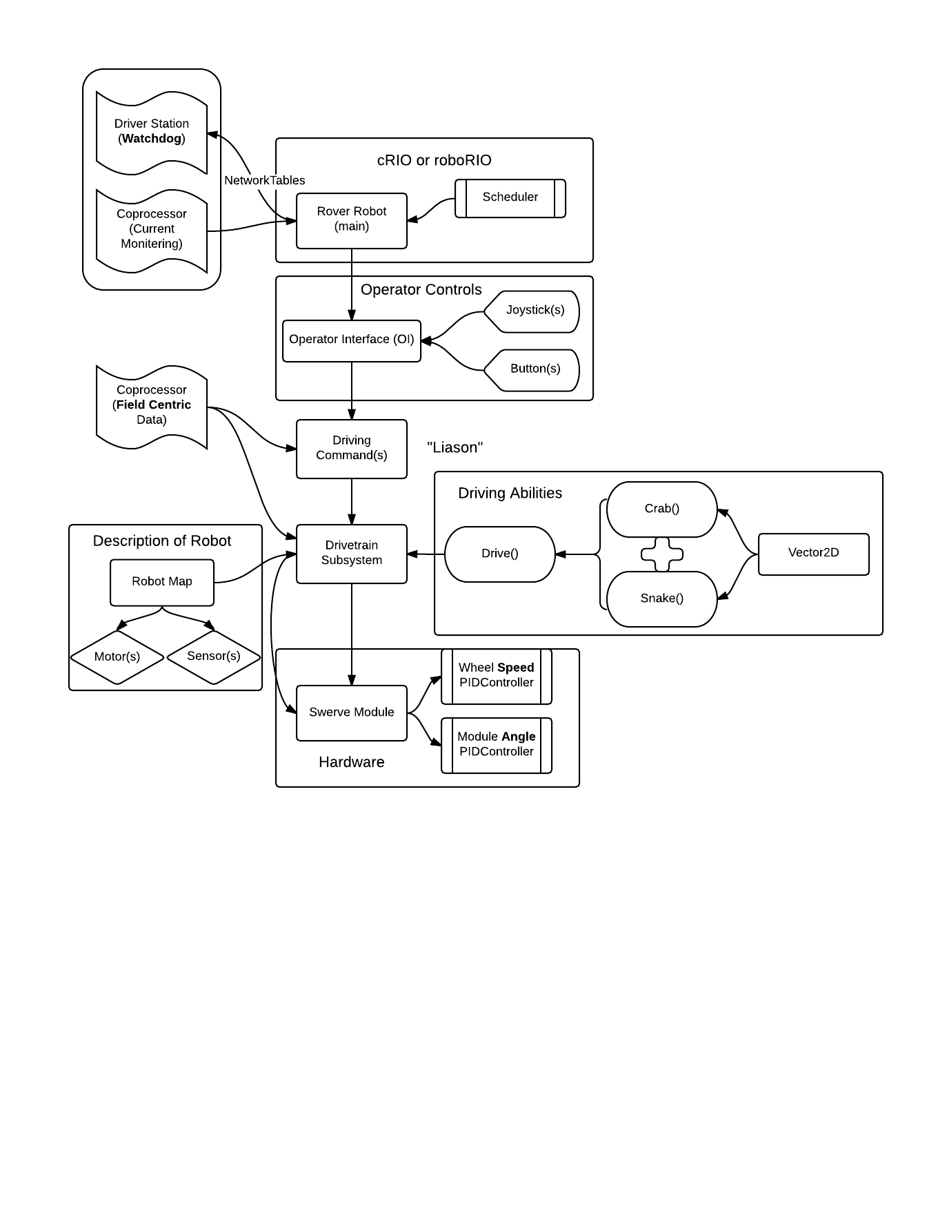
Rover Coding Overview

Slide 2
Individual Swerve Module Control
4 Modules
Each module contains 2 motors and 2 encoders
One pair for wheel speed
One pair for module angle
Speed and angle are both controlled by PID
Encoders for angle need to zero’ed before match
Limit switch on robot for driver to press when this is done
Maybe a mechanical hard stop
Each module can only rotate 3
times in either direction

Slide 3
Core Driving Math
Calculated using vectors (polar coords)
Wheel Speed = magnitude (r)
Module Angle = direction (θ)
Crab() is to move the robot in any direction
Snake() is to rotate around an arbitrary point
Add them together in Drive() to give for full functionality
Demo

Slide 4
Field Centric Control
So far, two options in mind:
NEATO LiDAR (to be tested at River Rage)
Nav6 gyro/accelerometer (needs testing)
Calculations for LiDAR must be done on coprocessor
Code will most likely be written in MATLAB
Its motor will need to be replaced by a FIRST legal one and wired to the cRIO
LiDAR runs at 10 Hz, which is not fast enough
A nav6 will be used to “fill in the gaps” of our LiDAR data

Slide 5

Watchdog Program (still being discussed)
Current on motors will be monitored by a coprocessor
The robot will send this data, along with other information, to the Driver Station laptop via Network Tables.
The Driver Station will then use this information to alert the driver of problems and log the state of the robot

